Slide 1


PETOPIA
GROUP 18:
RUTU CHOWGULE: 240845920071
SHREYAS NARLAWAR: 240845920086
PARUL SINGH: 240845920056
OMKAR TOTRE: 240845920054
MITALI PATIL: 240845920058

Slide 2
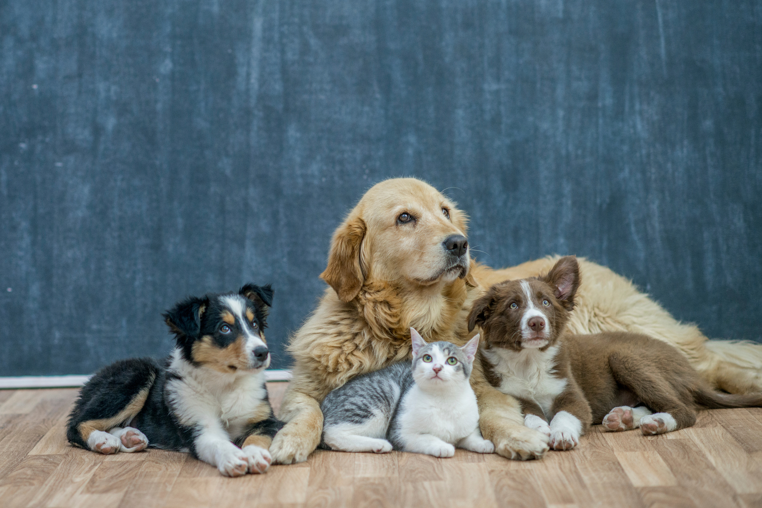
Table Of Content
About Our Project
DataBase
Data Flow
Use Case
Class Diagram
Sequence Diagram
Activity Diagram

Slide 3

About Petopia
Petopia is a web app designed to simplify pet adoption by connecting individuals directly with pet owners looking to rehome their pets. The platform allows users to browse available pets, communicate with each other, and arrange adoptions easily. Petopia fosters a community-driven approach to pet adoption, ensuring pets find loving homes through direct and transparent interactions.

Slide 4

Our DataBase
Consists of Seven Tables
Admin
Adoption_Status
Breed
Pet_Category
Pet_Images
Pet_Profile
Users

Slide 5
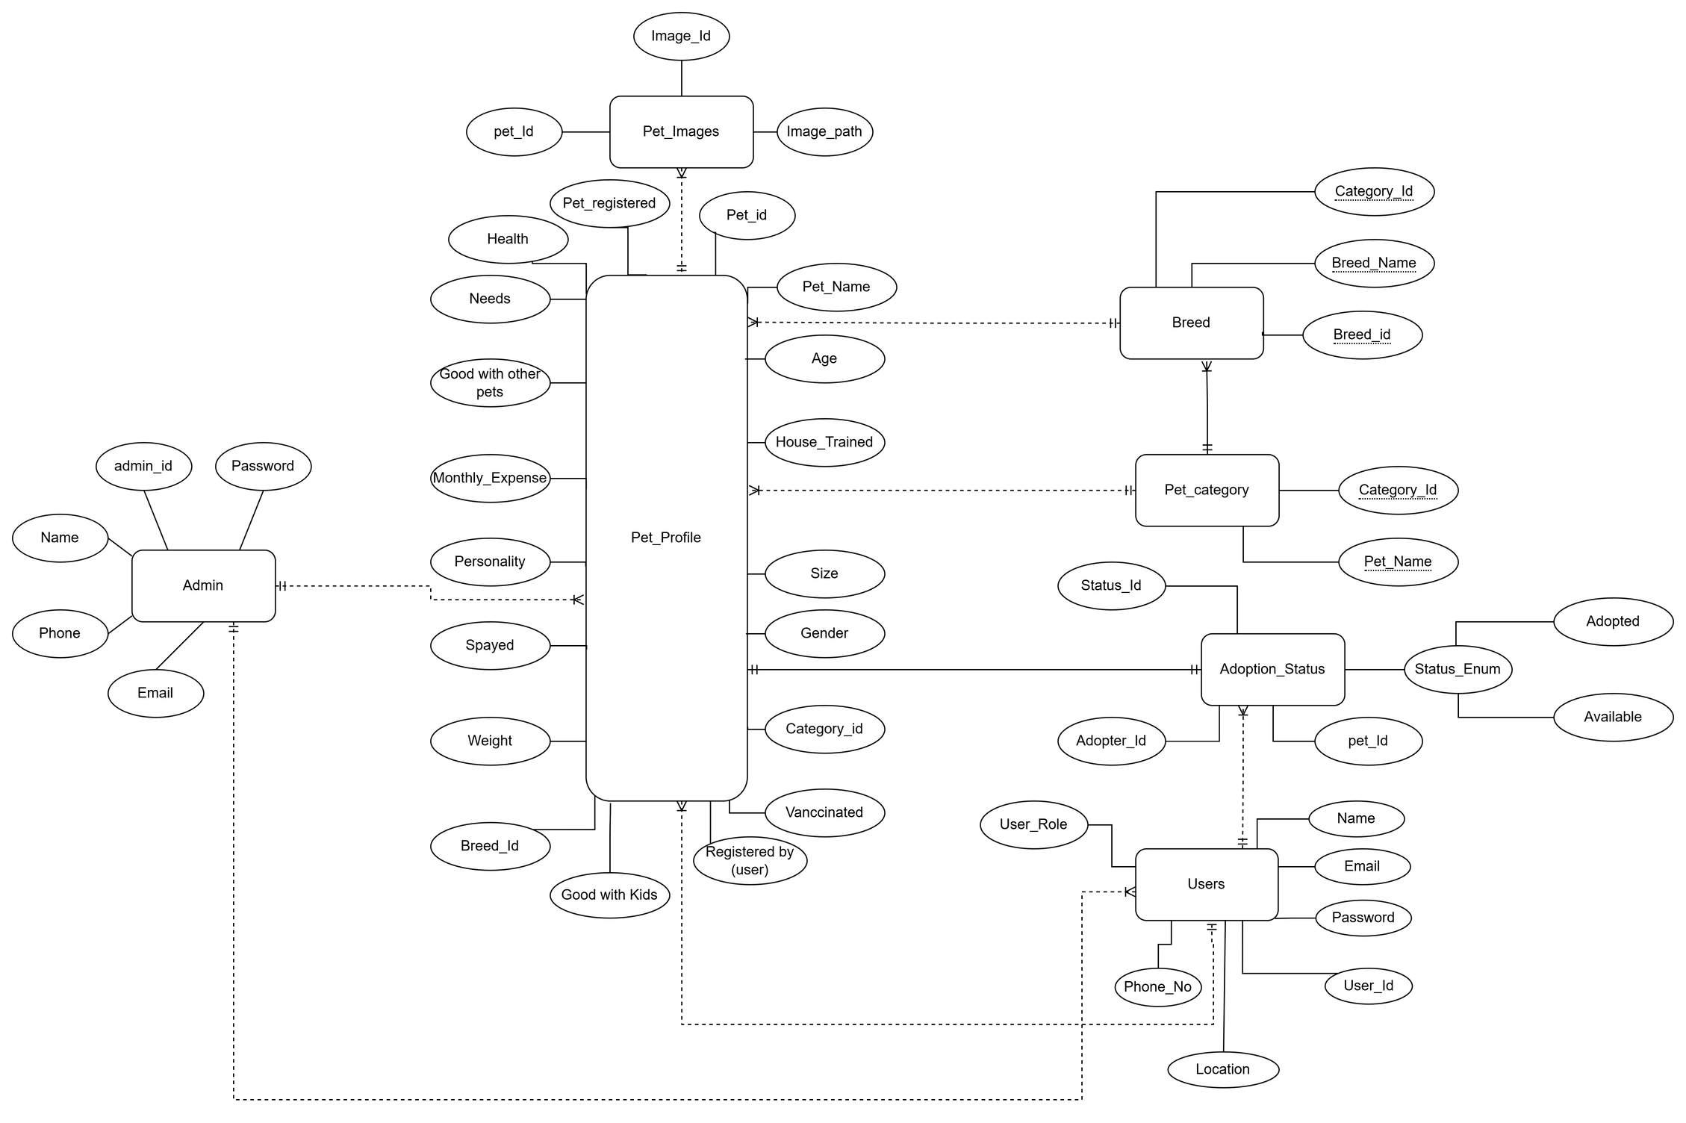
Entity Relation

Slide 6
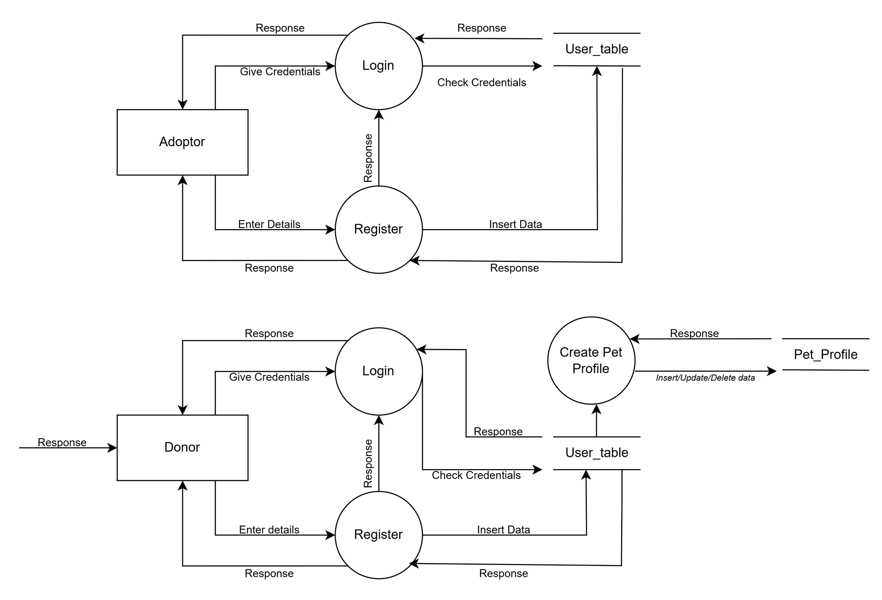
Data Flow

Slide 7
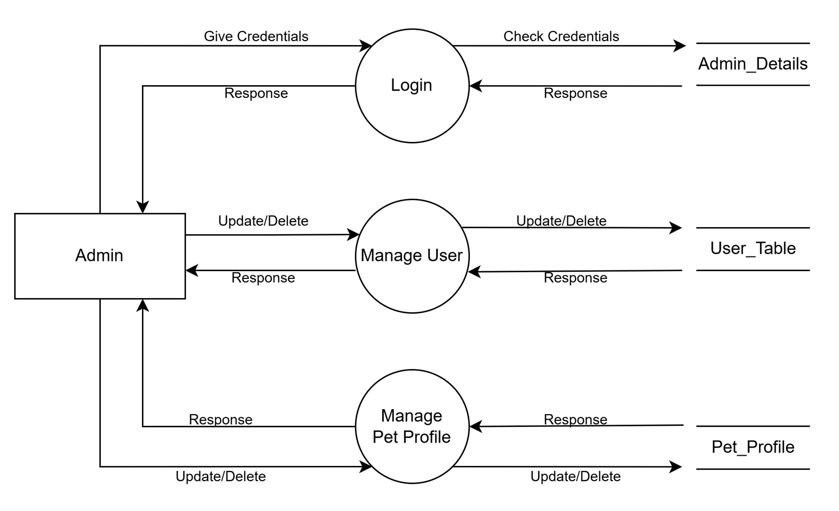
Data Flow

Slide 8
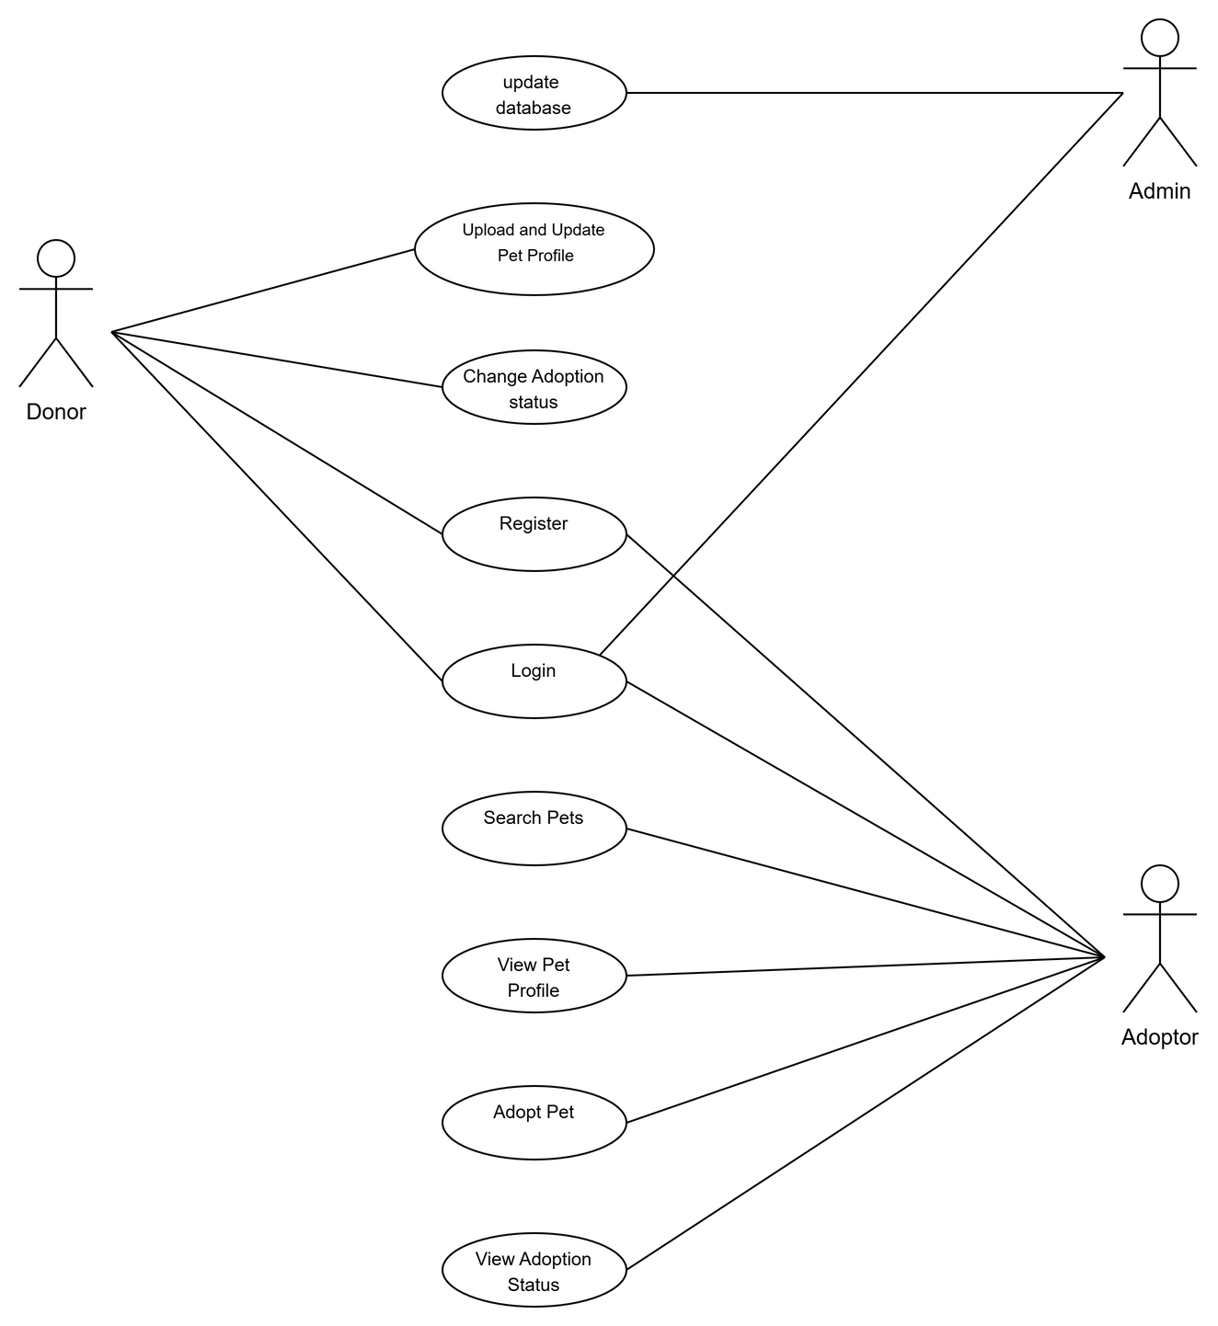
Use Case

Slide 9
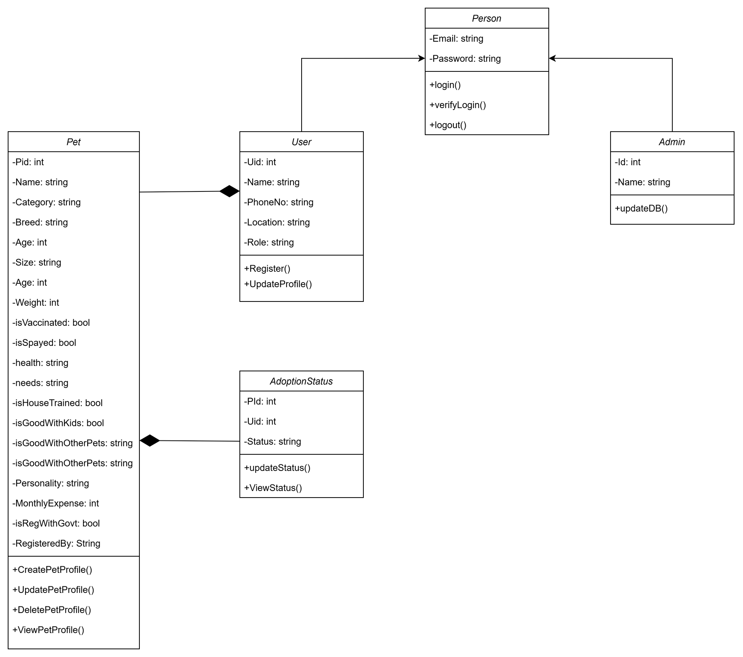
Class Diagram

Slide 10
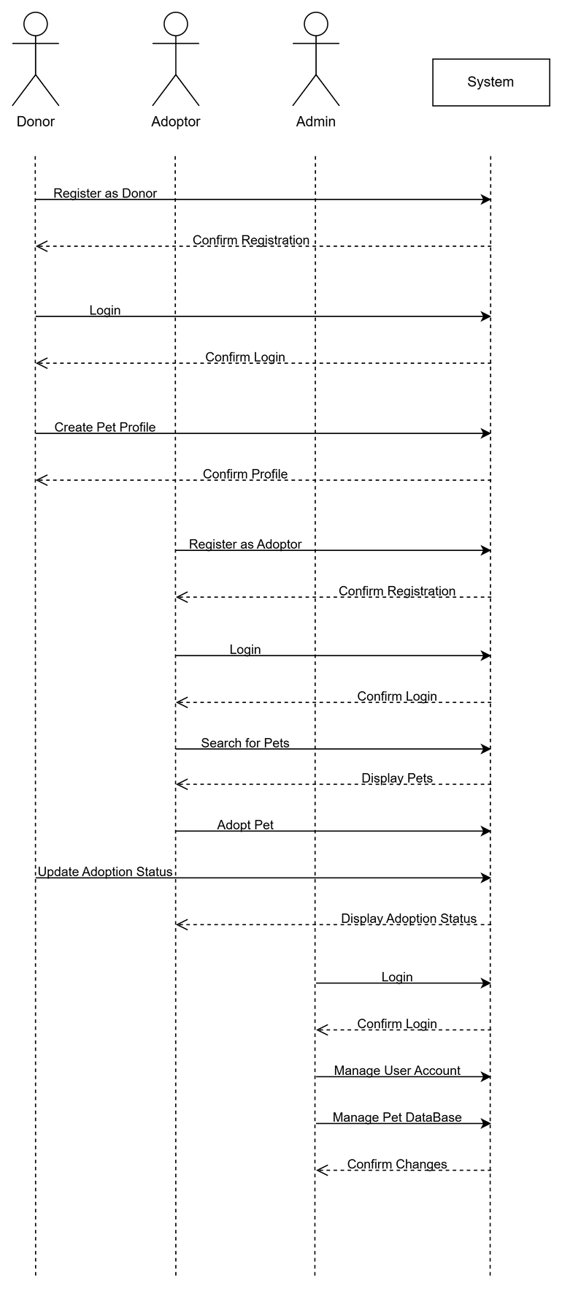
A sequence diagram is a type of UML (Unified Modeling Language) diagram that shows how processes or objects interact over time. It visually represents the order of messages exchanged between elements in a system.
Sequence

Slide 11
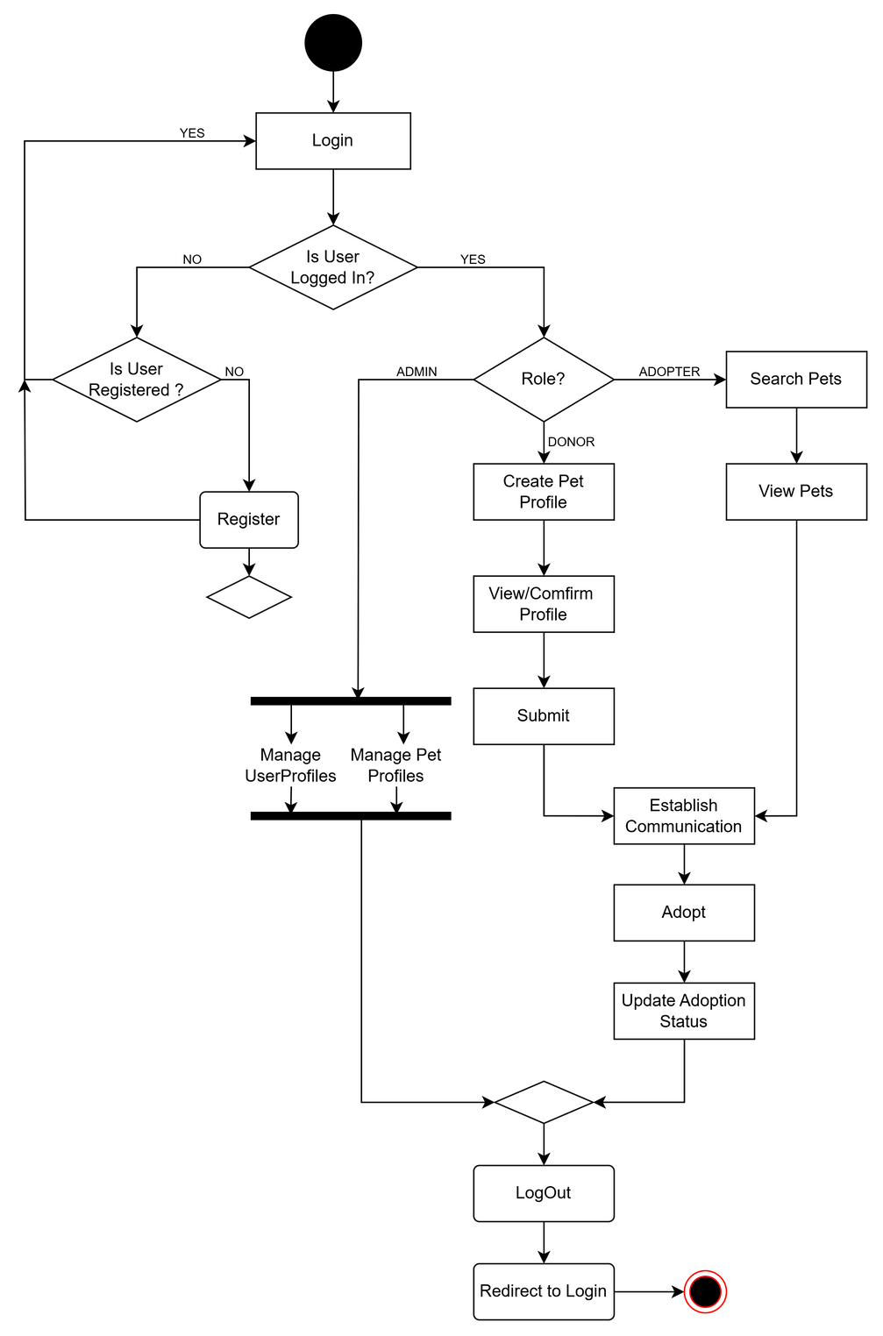
Activity Diagram

Slide 12

Thank You!
We’re now open to questions.

